Slide 1
Prizes, Publicity, and Patents – Non-Monetary Awards as a Mechanism to Encourage Innovation
Petra Moser and Tom Nicholas
Journal of Industrial Economics 2013

Slide 2
Prizes - an increasingly prominent alternative to patents
Socially valuable research fields in medicine, environmental science, and other fields, for which patents have failed to provide adequate incentives
Kremer 1998; Scotchmer 2004; Kalil 2006; Boldrin and Levine 2008
Medical Innovation Prize
Buy-out mechanism to compensate pharmaceutical firms for developing drugs that are socially valuable, but unattractive for private firms (Kremer and Williams 2010)
X-Prize
Super-fuel efficient vehicles
Techniques to clean up surface water oil
2010 America COMPETES Reauthorization Act
authorizes the NSF to use prizes to encourage innovation in underserved technologies of exceptional social value.

Slide 3
Uncertainty about effectiveness and especially mechanism
Theoretical analyses have focused on determining optimal amount of monetary compensation to incentivize invention
Polanvyi 1944; Wright 1983; Shavell and Ypersele 2001; Chari et al. 2009
Kremer (1998) develops an auction-based patent buyout mechanism to establish size of monetary prize to compensate inventors for social value of invention that enters public domain
But prizes may encourage innovation without a cash award
Historical analysis of 1,986 prizes for agricultural inventions that the Royal Society awarded in England between 1839 and 1939, (Brunt, Lerner, and Nicholas 2009)
Comparable increase in patenting for prizes without cash award

Slide 4
This paper: Do prizes encourage innovation? And if so, how?
Compare changes in patenting for technologies that won a prize at the Crystal Palace exhibition in 1851 with changes in patenting for technologies that were chosen to exhibit at the Crystal Palace, but did not win a prize
Control for variation in the demand for innovations and other unobservable factors that may have increased patenting after 1851, regardless of a prize
For example, U.S. inventors may have produced particularly valuable labor-saving innovations because labor was scarce relative to natural resources in the United States
Hicks 1932; Habbakuk 1962, and Acemoglu 2010
Making U.S. inventors more likely to win a prize for such technologies
Also cause an increase in patenting for labor-saving technologies after 1851
Control for quality of prize-winning innovations
Prize-winning innovations must be of a higher quality than other technologies
Produce more patents because of this quality differential, rather than because of the prize
All exhibits were selected through a rigorous selection process

Slide 5
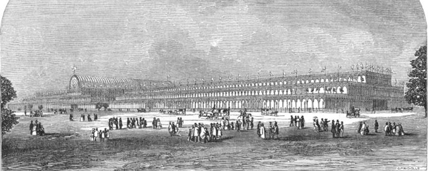
The Crystal Palace Fair in London, 1851
First international exhibition
1,848 foot-long pre-fab glass house
772,784 square feet
6 million visitors
17,062 exhibitors
574 U.S. exhibits
132 prize-winning U.S. exhibits

Slide 6
This paper: Do prizes encourage innovation? And if so, how?
Compare changes in patenting for technologies that won a prize at the Crystal Palace exhibition in 1851 with changes in patenting for technologies that were chosen to exhibit at the Crystal Palace, but did not win a prize
Control for variation in the demand for innovations and other unobservable factors that may have increased patenting after 1851, regardless of a prize
For example, U.S. inventors may have produced particularly valuable labor-saving innovations because labor was scarce relative to natural resources in the United States
Hicks 1932; Habbakuk 1962, and Acemoglu 2010
Making U.S. inventors more likely to win a prize for such technologies
Also cause an increase in patenting for labor-saving technologies after 1851
Control for quality of prize-winning innovations
Prize-winning innovations must be of a higher quality than other technologies
Produce more patents because of this quality differential, rather than because of the prize
All exhibits were selected through a rigorous selection process

Slide 7
Notes:
Add a reference to figure 1 in text

Slide 8
For prize-winning technologies, patents per subclass and year increase from 0.21 before to 0.71 after award of prize
Table 1 – Summary Statistics, U.S. Patent Issues per Subclass and Year, 1840-1870
Panel A: Prize-winners vs. other exhibits | Patents |  | Citations-weighted patents
 | pre-1851 | post-1851 | pre-1851 | post-1851
Prize-winning exhibits | 0.212 | 0.712 | 0.243 | 0.805
 | (0.559) | (1.438) | (0.680) | (1.695)
Control: other exhibits | 0.181 | 0.420 | 0.218 | 0.482
 | (0.569) | (1.006) | (0.724) | (1.198)
Panel B: Prize-winners vs. published inventions | Patents |  | Citations-weighted patents
 | pre-1851 | post-1851 | pre-1851 | post-1851
Prize-winning exhibit | 0.212 | 0.712 | 0.243 | 0.805
 | (0.559) | (1.438) | (0.680) | (1.695)
Other subclasses in same class | 0.169 | 0.422 | 0.196 | 0.463
 | (0.461) | (1.041) | (0.578) | (1.154)
All other subclasses | 0.142 | 0.341 | 0.166 | 0.378
 | (0.404) | (0.935) | (0.517) | (1.050)
Lead article in Scientific American | 0.107 | 0.707 | 0.111 | 0.747
 | (0.391) | (1.646) | (0.403) | (1.701)
Other subclasses in same class | 0.144 | 0.364 | 0.164 | 0.400
 | (0.398) | (0.908) | (0.486) | (1.013)
All other subclasses | 0.144 | 0.342 | 0.168 | 0.379
 | (0.407) | (0.932) | (0.521) | (1.051)

Slide 9
For other exhibits, patents per subclass and year increase from 0.18 before to 0.42 after the prize
Table 1 – Summary Statistics, U.S. Patent Issues per Subclass and Year, 1840-1870
Panel A: Prize-winners vs. other exhibits | Patents |  | Citations-weighted patents
 | pre-1851 | post-1851 | pre-1851 | post-1851
Prize-winning exhibits | 0.212 | 0.712 | 0.243 | 0.805
 | (0.559) | (1.438) | (0.680) | (1.695)
Control: other exhibits | 0.181 | 0.420 | 0.218 | 0.482
 | (0.569) | (1.006) | (0.724) | (1.198)
Panel B: Prize-winners vs. published inventions | Patents |  | Citations-weighted patents
 | pre-1851 | post-1851 | pre-1851 | post-1851
Prize-winning exhibit | 0.212 | 0.712 | 0.243 | 0.805
 | (0.559) | (1.438) | (0.680) | (1.695)
Other subclasses in same class | 0.169 | 0.422 | 0.196 | 0.463
 | (0.461) | (1.041) | (0.578) | (1.154)
All other subclasses | 0.142 | 0.341 | 0.166 | 0.378
 | (0.404) | (0.935) | (0.517) | (1.050)
Lead article in Scientific American | 0.107 | 0.707 | 0.111 | 0.747
 | (0.391) | (1.646) | (0.403) | (1.701)
Other subclasses in same class | 0.144 | 0.364 | 0.164 | 0.400
 | (0.398) | (0.908) | (0.486) | (1.013)
All other subclasses | 0.144 | 0.342 | 0.168 | 0.379
 | (0.407) | (0.932) | (0.521) | (1.051)

Slide 10
Controlling for variation in patenting across technologies and over time, this implies a 43% increase in patenting for prize-winning technologies
Table 2 – Changes in Patenting after 1851 for Prize-winning Compared with other Exhibited Technologies, Negative Binomial and OLS Regressions. Dependent Variable is Patents per Subclass and Year, 1840-70
 | Negative Binomial (1-3) |  |  | OLS (4-6)
 | (1) | (2) | (3) | (4) | (5) | (6)
post-1851 x prize | 0.358*** | 0.471* | 0.353** | 0.261** | 0.245* | 0.279**
 | [0.133] | [0.246] | [0.140] | [0.122] | [0.132] | [0.131]
Constant | 0.658*** | 0.770*** | -0.270 | 0.392*** | 0.433*** | 0.113
 | [0.186] | [0.214] | [0.490] | [0.058] | [0.074] | [0.158]
Subclass f.e. | Yes | Yes | Yes | Yes | Yes | Yes
Year f.e. | Yes | Yes | Yes | Yes | Yes | Yes
Pre-trends | - | Yes | - | - | Yes | -
Technology trend | - | - | Yes | - | - | Yes
*** p<0.01, ** p<0.05, * p<0.1
Subclasses | 158 | 158 | 158 | 158 | 158 | 158
N | 4,898 | 4,898 | 4,898 | 4,898 | 4,898 | 4,898
R-squared | - | - | - | 0.08 | 0.08 | 0.09

Slide 11
Controlling for variation in patenting across technologies and over time, this implies a 43% increase in patenting for prize-winning technologies
Table 2 – Changes in Patenting after 1851 for Prize-winning Compared with other Exhibited Technologies, Negative Binomial and OLS Regressions. Dependent Variable is Patents per Subclass and Year, 1840-70
 | Negative Binomial (1-3) |  |  | OLS (4-6)
 | (1) | (2) | (3) | (4) | (5) | (6)
 |  | exp(0.358) – 1 | =0.430
post-1851 x prize | 0.358*** | 0.471* | 0.353** | 0.261** | 0.245* | 0.279**
 | [0.133] | [0.246] | [0.140] | [0.122] | [0.132] | [0.131]
Constant | 0.658*** | 0.770*** | -0.270 | 0.392*** | 0.433*** | 0.113
 | [0.186] | [0.214] | [0.490] | [0.058] | [0.074] | [0.158]
Subclass f.e. | Yes | Yes | Yes | Yes | Yes | Yes
Year f.e. | Yes | Yes | Yes | Yes | Yes | Yes
Pre-trends | - | Yes | - | - | Yes | -
Technology trend | - | - | Yes | - | - | Yes
*** p<0.01, ** p<0.05, * p<0.1
Subclasses | 158 | 158 | 158 | 158 | 158 | 158
N | 4,898 | 4,898 | 4,898 | 4,898 | 4,898 | 4,898
R-squared | - | - | - | 0.08 | 0.08 | 0.09

Slide 12
Controlling for pre-trends increases estimate to 60%
Table 2 – Changes in Patenting after 1851 for Prize-winning Compared with other Exhibited Technologies, Negative Binomial and OLS Regressions. Dependent Variable is Patents per Subclass and Year, 1840-70
 | Negative Binomial (1-3) |  |  | OLS (4-6)
 | (1) | (2) | (3) | (4) | (5) | (6)
post-1851 x prize | 0.358*** | 0.471* | 0.353** | 0.261** | 0.245* | 0.279**
 | [0.133] | [0.246] | [0.140] | [0.122] | [0.132] | [0.131]
Constant | 0.658*** | 0.770*** | -0.270 | 0.392*** | 0.433*** | 0.113
 | [0.186] | [0.214] | [0.490] | [0.058] | [0.074] | [0.158]
Subclass f.e. | Yes | Yes | Yes | Yes | Yes | Yes
Year f.e. | Yes | Yes | Yes | Yes | Yes | Yes
Pre-trends | - | Yes | - | - | Yes | -
Technology trend | - | - | Yes | - | - | Yes
*** p<0.01, ** p<0.05, * p<0.1
Subclasses | 158 | 158 | 158 | 158 | 158 | 158
N | 4,898 | 4,898 | 4,898 | 4,898 | 4,898 | 4,898
R-squared | - | - | - | 0.08 | 0.08 | 0.09
Notes:
For pre-trends, we include in the regression a linear time-trend variable that is equal to prize * (year-1839) for years strictly less than 1851, and 0 thereafter. We also include a quadratic time trend variable that is equal to prize * (year-1839) ^2, and 0 thereafter.

Slide 13
Controlling for trends at the level of five technologies (chemical, communication, medical, electrical, and mechanical) implies a 42% increase
Table 2 – Changes in Patenting after 1851 for Prize-winning Compared with other Exhibited Technologies, Negative Binomial and OLS Regressions. Dependent Variable is Patents per Subclass and Year, 1840-70
 | Negative Binomial (1-3) |  |  | OLS (4-6)
 | (1) | (2) | (3) | (4) | (5) | (6)
post-1851 x prize | 0.358*** | 0.471* | 0.353** | 0.261** | 0.245* | 0.279**
 | [0.133] | [0.246] | [0.140] | [0.122] | [0.132] | [0.131]
Constant | 0.658*** | 0.770*** | -0.270 | 0.392*** | 0.433*** | 0.113
 | [0.186] | [0.214] | [0.490] | [0.058] | [0.074] | [0.158]
Subclass f.e. | Yes | Yes | Yes | Yes | Yes | Yes
Year f.e. | Yes | Yes | Yes | Yes | Yes | Yes
Pre-trends | - | Yes | - | - | Yes | -
Technology trend | - | - | Yes | - | - | Yes
*** p<0.01, ** p<0.05, * p<0.1
Subclasses | 158 | 158 | 158 | 158 | 158 | 158
N | 4,898 | 4,898 | 4,898 | 4,898 | 4,898 | 4,898
R-squared | - | - | - | 0.08 | 0.08 | 0.09

Slide 14
OLS yields slightly larger estimates: 0.26 additional patents per subclass and year; implying 50% increase (compared with 0.52 patents per subclass and year after 1851)
Table 2 – Changes in Patenting after 1851 for Prize-winning Compared with other Exhibited Technologies, Negative Binomial and OLS Regressions. Dependent Variable is Patents per Subclass and Year, 1840-70
 | Negative Binomial (1-3) |  |  | OLS (4-6)
 | (1) | (2) | (3) | (4) | (5) | (6)
post-1851 x prize | 0.358*** | 0.471* | 0.353** | 0.261** | 0.245* | 0.279**
 | [0.133] | [0.246] | [0.140] | [0.122] | [0.132] | [0.131]
Constant | 0.658*** | 0.770*** | -0.270 | 0.392*** | 0.433*** | 0.113
 | [0.186] | [0.214] | [0.490] | [0.058] | [0.074] | [0.158]
Subclass f.e. | Yes | Yes | Yes | Yes | Yes | Yes
Year f.e. | Yes | Yes | Yes | Yes | Yes | Yes
Pre-trends | - | Yes | - | - | Yes | -
Technology trend | - | - | Yes | - | - | Yes
*** p<0.01, ** p<0.05, * p<0.1
Subclasses | 158 | 158 | 158 | 158 | 158 | 158
N | 4,898 | 4,898 | 4,898 | 4,898 | 4,898 | 4,898
R-squared | - | - | - | 0.08 | 0.08 | 0.09

Slide 15
With additional controls for pre-trends, OLS estimates 0.245 additional patents per subclass and year, implying an increase of 47 percent
Table 2 – Changes in Patenting after 1851 for Prize-winning Compared with other Exhibited Technologies, Negative Binomial and OLS Regressions. Dependent Variable is Patents per Subclass and Year, 1840-70
 | Negative Binomial (1-3) |  |  | OLS (4-6)
 | (1) | (2) | (3) | (4) | (5) | (6)
post-1851 x prize | 0.358*** | 0.471* | 0.353** | 0.261** | 0.245* | 0.279**
 | [0.133] | [0.246] | [0.140] | [0.122] | [0.132] | [0.131]
Constant | 0.658*** | 0.770*** | -0.270 | 0.392*** | 0.433*** | 0.113
 | [0.186] | [0.214] | [0.490] | [0.058] | [0.074] | [0.158]
Subclass f.e. | Yes | Yes | Yes | Yes | Yes | Yes
Year f.e. | Yes | Yes | Yes | Yes | Yes | Yes
Pre-trends | - | Yes | - | - | Yes | -
Technology trend | - | - | Yes | - | - | Yes
*** p<0.01, ** p<0.05, * p<0.1
Subclasses | 158 | 158 | 158 | 158 | 158 | 158
N | 4,898 | 4,898 | 4,898 | 4,898 | 4,898 | 4,898
R-squared | - | - | - | 0.08 | 0.08 | 0.09
Notes:
For pre-trends, we include in the regression a linear time-trend variable that is equal to prize * (year-1839) for years strictly less than 1851, and 0 thereafter. We also include a quadratic time trend variable that is equal to prize * (year-1839) ^2, and 0 thereafter.

Slide 16
With additional controls for technology trends, OLS estimates 0.279 additional patents per subclass and year, implying an increase of 53 percent
Table 2 – Changes in Patenting after 1851 for Prize-winning Compared with other Exhibited Technologies, Negative Binomial and OLS Regressions. Dependent Variable is Patents per Subclass and Year, 1840-70
 | Negative Binomial (1-3) |  |  | OLS (4-6)
 | (1) | (2) | (3) | (4) | (5) | (6)
post-1851 x prize | 0.358*** | 0.471* | 0.353** | 0.261** | 0.245* | 0.279**
 | [0.133] | [0.246] | [0.140] | [0.122] | [0.132] | [0.131]
Constant | 0.658*** | 0.770*** | -0.270 | 0.392*** | 0.433*** | 0.113
 | [0.186] | [0.214] | [0.490] | [0.058] | [0.074] | [0.158]
Subclass f.e. | Yes | Yes | Yes | Yes | Yes | Yes
Year f.e. | Yes | Yes | Yes | Yes | Yes | Yes
Pre-trends | - | Yes | - | - | Yes | -
Technology trend | - | - | Yes | - | - | Yes
*** p<0.01, ** p<0.05, * p<0.1
Subclasses | 158 | 158 | 158 | 158 | 158 | 158
N | 4,898 | 4,898 | 4,898 | 4,898 | 4,898 | 4,898
R-squared | - | - | - | 0.08 | 0.08 | 0.09

Slide 17
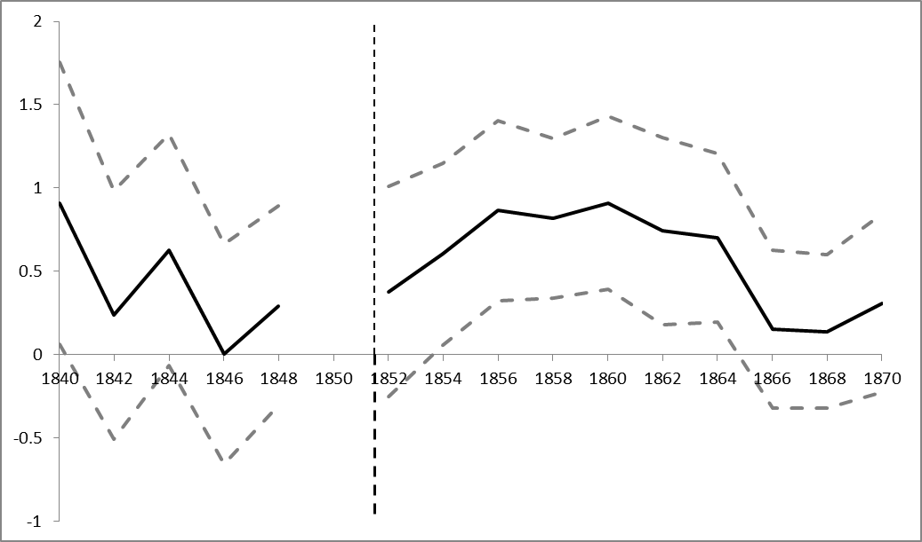
Estimates become statistically significant 3 years after 1851 and remain significant until 1865

Slide 18
Controlling for broader technology trends

Slide 19
32 percent increase in patenting compared with all subclasses in same class and 35 percent increase compared with all subclasses
Table 3 – Estimates of "Prize Effects" Changes in Patenting after 1851 for Prize-winning Compared with other USPTO patents
 | Control: All Subclasses in same Class (1-3) |  |  | Control: All Subclasses (4-6)
 | (1) | (2) | (3) | (4) | (5) | (6)
 | Panel A: Negative Binomial
post-1851 x prize | 0.275*** | 0.296 | 0.261** | 0.301*** | 0.284 | 0.277***
 | [0.107] | [0.193] | [0.107] | [0.103] | [0.180] | [0.103]
Constant | 0.478*** | 0.484*** | -2.456** | 0.475*** | 0.477*** | -0.078
 | [0.088] | [0.090] | [0.998] | [0.047] | [0.048] | [0.158]
 | Panel B: OLS
post-1851 x prize | 0.248** | 0.286** | 0.254** | 0.301*** | 0.365*** | 0.292***
 | [0.112] | [0.123] | [0.111] | [0.110] | [0.121] | [0.110]
Constant | 0.262*** | 0.259*** | 0.110*** | 0.218*** | 0.217*** | 0.151***
 | [0.019] | [0.019] | [0.018] | [0.008] | [0.008] | [0.034]
Subclass f.e. | Yes | Yes | Yes | Yes | Yes | Yes
Year f.e. | Yes | Yes | Yes | Yes | Yes | Yes
Pre-trends | - | Yes | - | - | Yes | -
Technology trend | - | - | Yes | - | - | Yes
*** p<0.01, ** p<0.05, * p<0.1
Subclasses | 906 | 906 | 906 | 4,055 | 4,055 | 4,055
N | 28,086 | 28,086 | 28,086 | 125,705 | 125,705 | 125,705
R-squared (for OLS) | 0.09 | 0.09 | 0.10 | 0.08 | 0.08 | 0.08

Slide 20
Does the prize encourage a fad in low-quality patents? – No.
Notes:
From 1840 to 1852, patent issues per year closely track each other in prize-winning and other subclasses, increasing slowly from 0.1 in 1840 to 0.2 in 1852

Slide 21
Controlling for patent quality implies a larger increase of 54% (compared with 43% for raw patents)
Table 4 – Controlling for Patent Quality: Changes in Patenting after 1851 for Prize-winning Compared with other Exhibited Technologies
 | Negative Binomial (1-3) |  |  | OLS (4-6)
 | (1) | (2) | (3) | (4) | (5) | (6)
post-1851 x prize | 0.432*** | 0.600*** | 0.384*** | 0.298** | 0.226 | 0.330**
 | [0.126] | [0.183] | [0.131] | [0.146] | [0.168] | [0.161]
Constant | 0.035 | 0.110 | -1.316*** | 0.468*** | 0.529*** | -0.008
 | [0.165] | [0.186] | [0.376] | [0.071] | [0.091] | [0.276]
Subclass f.e. | Yes | Yes | Yes | Yes | Yes | Yes
Year f.e. | Yes | Yes | Yes | Yes | Yes | Yes
Pre-trends | - | Yes | - | - | Yes | -
Technology trend | - | - | Yes | - | - | Yes
*** p<0.01, ** p<0.05, * p<0.1
Subclasses | 158 | 158 | 158 | 158 | 158 | 158
N | 4,898 | 4,898 | 4,898 | 4,898 | 4,898 | 4,898
R-squared | - | - | - | 0.07 | 0.07 | 0.08

Slide 22
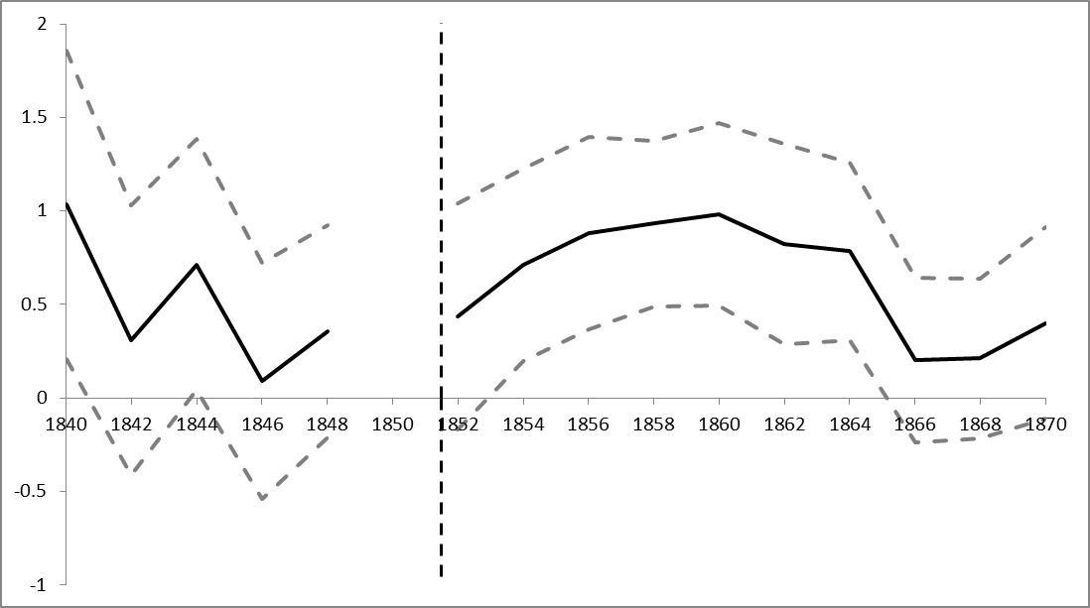
Controlling for quality

Slide 23
Controlling for the quality of patents and for technology trends, estimates become statistically significant one year after 1851 and remain significant until 1865

Slide 24
How did prizes encourage innovation?
Samuel Colt to his cousin Elisha Colt, July 18 1849:
Thees medles we must get & I must have them with me in Europe to help make up the reputation of my arms as soon as I begin to make a noyes about them & I must get duplicates of the old ones that have been lost all these things go a grate ways in Europe & it would pay for a special trip to America to secure them if they cannot be got without my presence there.
Publicity as a mechanism to encourage invention?
Compare changes in patenting for technologies that were described on the front page of the Scientific American in 1851 with changes for a control group of technologies without such publicity
Established in 1845, one of the premier science journals of the time
Sold roughly 10,000 copies in 1848, 20,000 in 1852, 30,000 in 1853, and stayed at this level into the 1860s
New York Times 25,000 copies of its weekly edition in 1850

Slide 27
Technologies that were advertised in the Scientific American in 1851 produced 102% additional patents after 1851

Slide 28
OLS estimates imply a 99% increase 0.380 additional patents compared with 0.383 patents per subclass and year after 1851

Slide 29
Conclusions
Prizes appear to have encouraged patenting
Prize-winning technology fields experienced a 40% increase in patenting after prize
Increase begins after 2 years, persists for 12 years
No evidence of fad (low quality patents)
Controlling for the quality of patents increases estimated increase to 53%
Same temporal pattern of increase
Publicity as a mechanism
Comparable increase for inventions published in Scientific American

